Slide 1
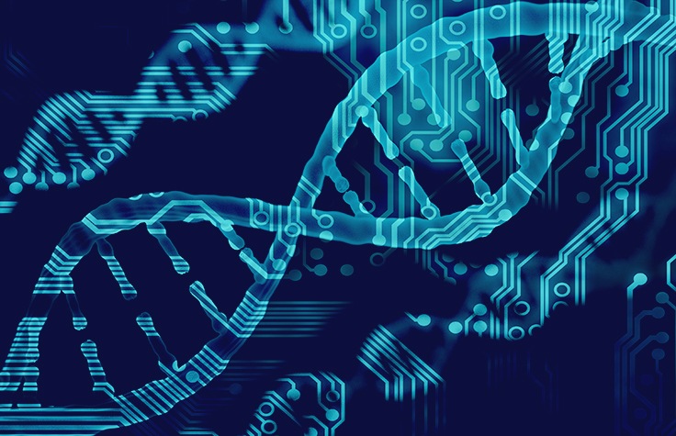
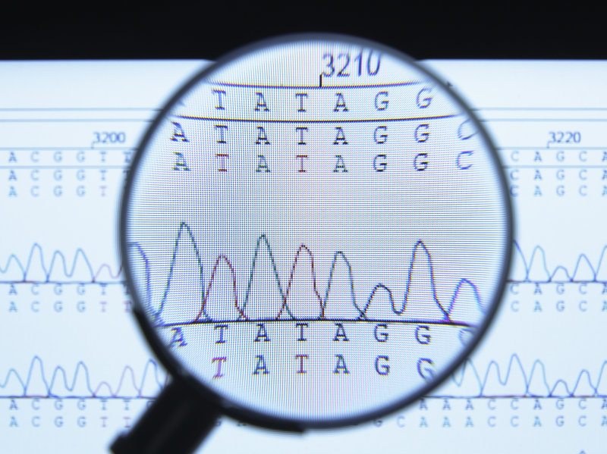
Genome Sequencing
Md Mazedul Haq

Slide 2
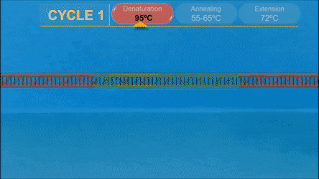
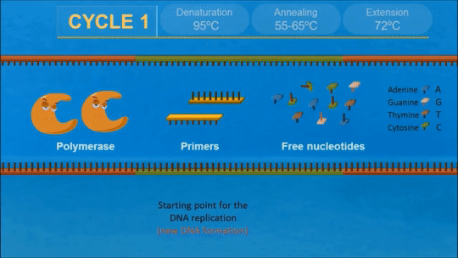
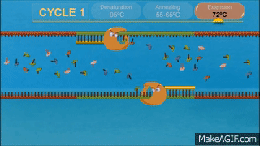
Polymearase Chain Reaction

Slide 3
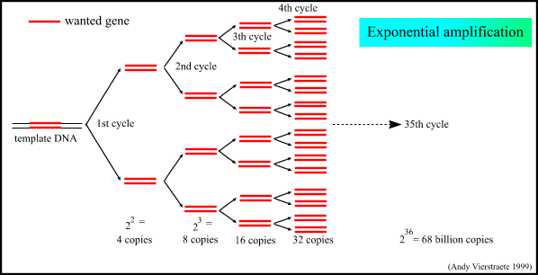
Target Gene Amplification

Slide 4
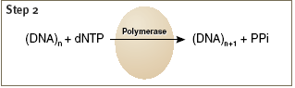
Pyrosequencing
The target DNA is first amplified by polymerase chain reaction (PCR).
While the number of cycles in reg-ular PCR is around 30, the number of cycles in PCR for pyrosequencing is around 50.
One of the two PCR primers is biotinylated at the 5’-end.
The biotinylated strand is used as the template for pyrosequencing.
Four enzymes—DNA polymerase, ATP sulfurylase, luciferase, apyrase, and two substrates - adenosine 5’-phosphosulfate (APS) and luciferin.
Then, individual dNTPs are added to the reaction sequentially in a fixed order, which is programmed before the run.
If the added dNTP is complementary to the base in the template strand, it is incorporated by the DNA polymerase and a pyrophosphate (PPi) is released.

Slide 5
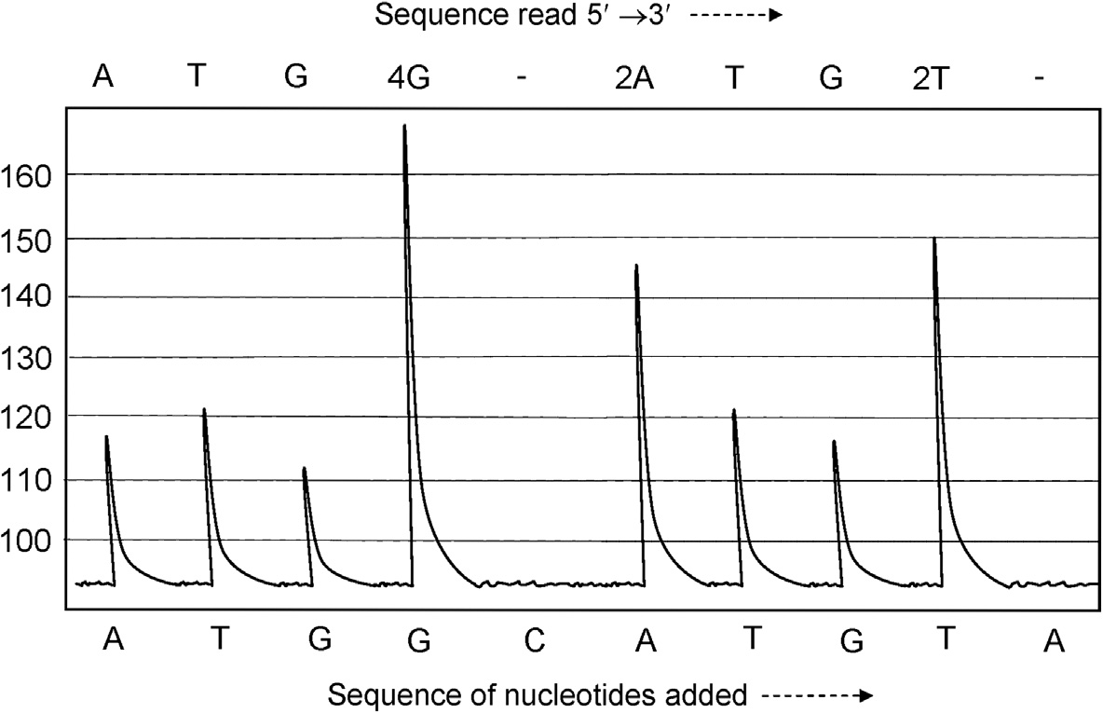
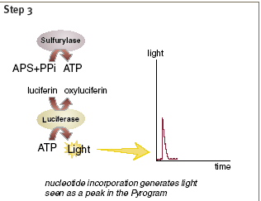
Pyrosequencing
ATP sulfurylase uses this PPi and APS to generate ATP.
The ATP is utilized by luciferase to oxidize luciferin into oxyluciferin with the concomitant emission of light, which is recorded by a charge-coupled device (CCD) camera in the form of a peak.
the peak height is directly proportional to the number of nucleotide incorporated in tandem. If two of the same bases are incorporated back to back, the peak height becomes double, and so on.
If the injected dNTP is not complementary to the template base, no signal is produced.

Slide 6
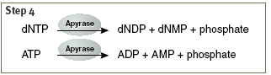
Principle of Pyrosequencing
Apyrase, a nucleotide degrading enzyme, continuously degrades unincorporated dNTPs and excess ATP. When degradation is complete, another dNTP is added.
As the process continues, the complementary DNA strand is built up and the nucleotide sequence is determined from the signal peak in the pyrogram.

Slide 7
Quantification of mutation
A>G normal
A>G heteroplasmic

Slide 8
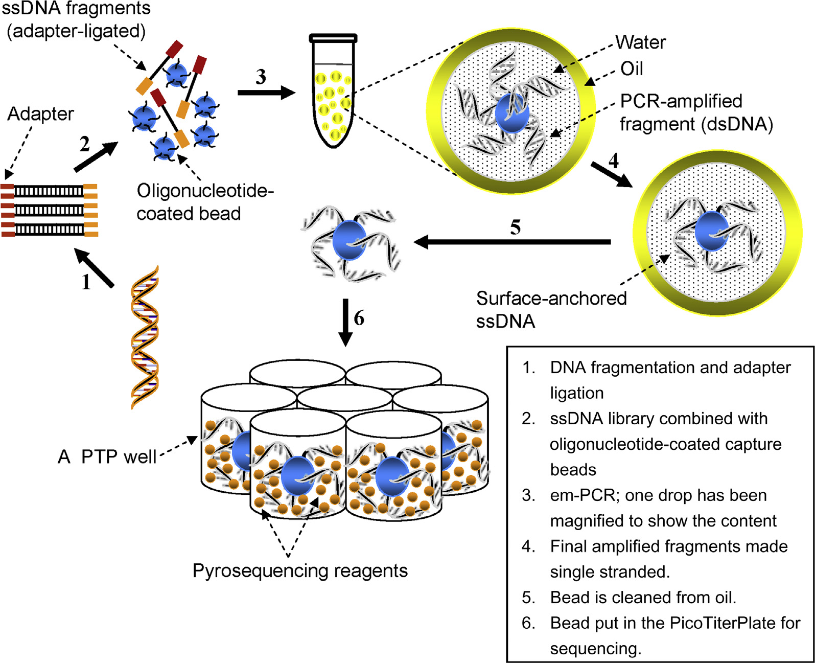
Next Generation Sequencing Platform
ROCHE 454

Slide 9
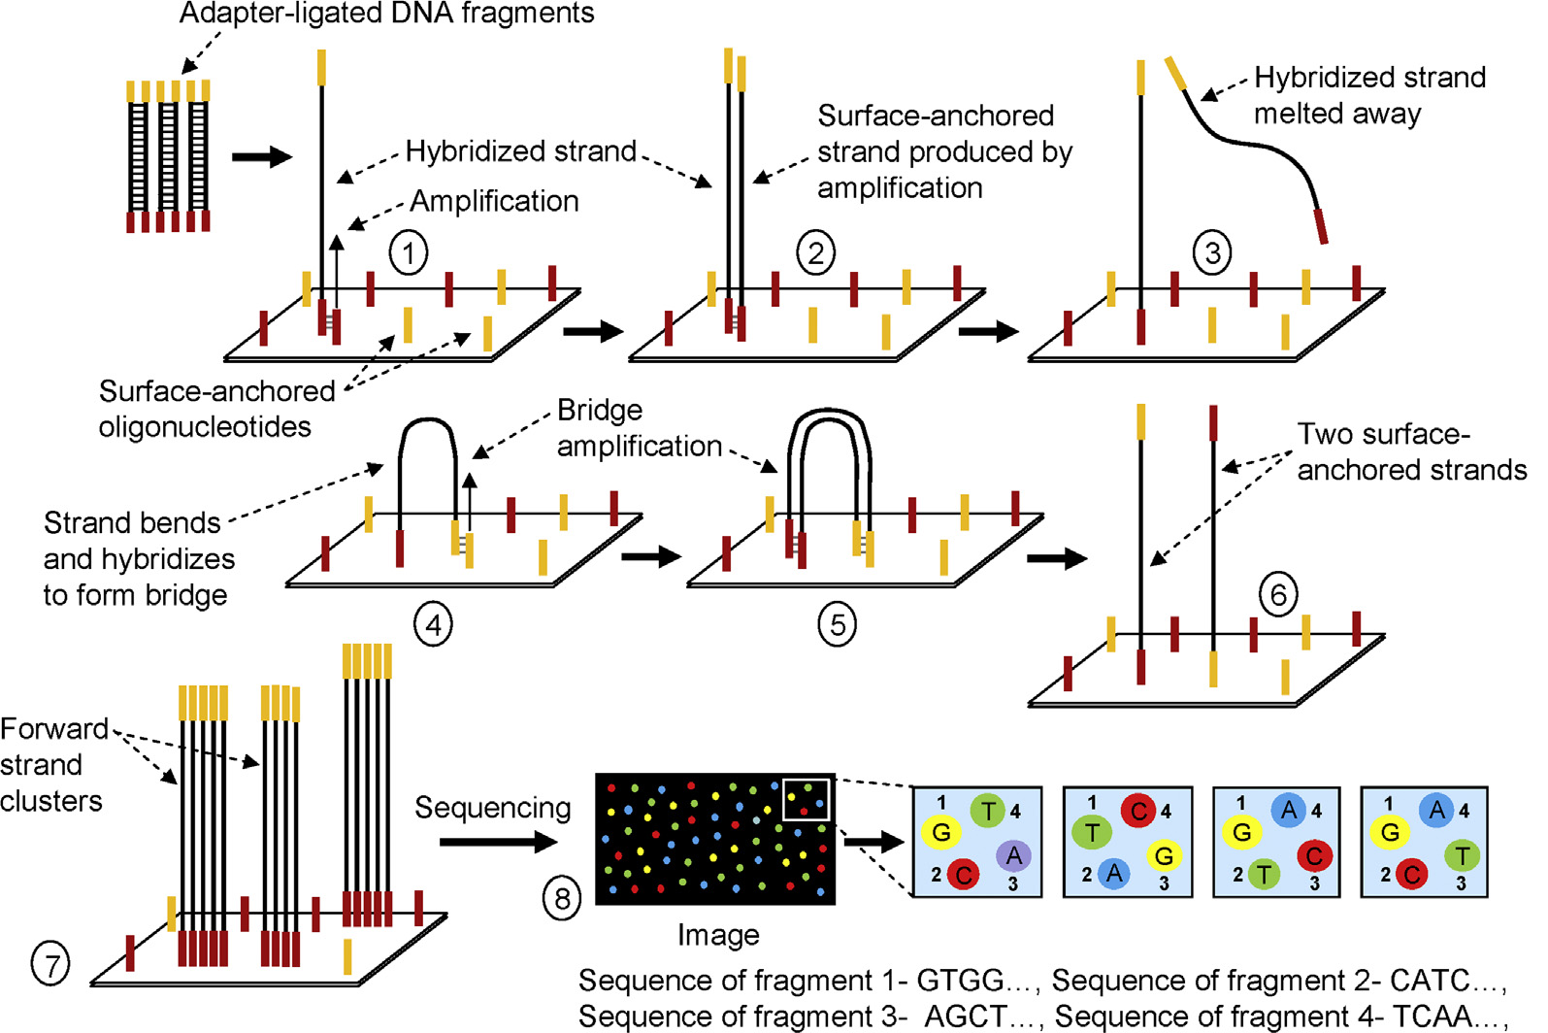
Next Generation Sequencing Platform
ILLUMINA SOLEXA
The DNA-sequencing library is prepared by ligating adapters to the end-polished DNA fragments. The single-stranded fragments are allowed to hybridize with surface-anchored oligonucleotides that are complementary to the adapters. Initial PCR amplification of the strands followed by bridge (PCR) amplification results in the generation of single-stranded clusters. The strands are then sequenced using fluorescent reversible terminator chemistry.

Slide 10
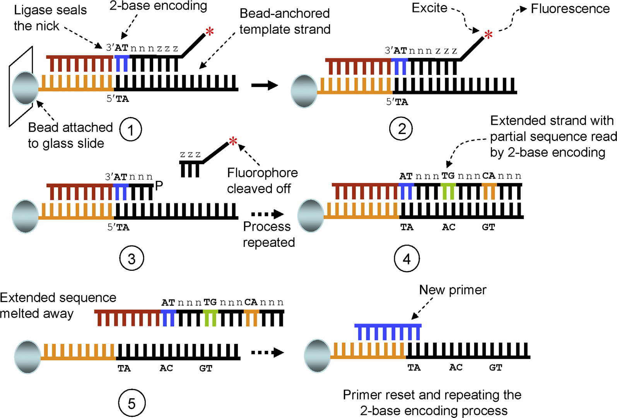
Next Generation Sequencing Platform
SOLiD
The DNA-sequencing library is prepared by ligating adapters to the end-polished DNA
fragments, and immobilized on paramagnetic beads. The fragments on the beads are amplified by em-PCR, the extended templates on the beads are 3’-end modified, and the beads are immobilized on a glass slide. The sequencing-by-ligation chemistry utilizes a two-base encoding query system for interrogating the sequence and a fluorescent dye for detection.

Slide 11
Next-Next generation Sequencing
First-generation sequencing technology have the slow progress, and high cost.
The second-generation (Next generation) sequencing technology platforms have their own technical problems:
fluorescent nucleotide labeling is not fully efficient,
exonucleases are inefficient with labeled nucleotide,
detection of single-molecule fluorescence has a high error rate because of the inherent noise in a fluorescence-driven base call,
and the same strand can not be “re-read.”

Slide 12
Microarray
Conventional expression analysis only allows the study of the expression of a single gene in a single experiment.
The highly parallel nature of microarrays allows the simultaneous study of the expression of thousands or even tens of thousands of different genes in a single experiment.
Microarrays allow researchers to undertake global expression analysis that is not feasible with conventional techniques

Slide 13
What Microarrays can Detect?
What genes are present or absent in a cell
What genes are present or absent in the experiment vs. control
Which genes have increased or decreased expression in experiments vs. control
Which genes have biological significance

Slide 14
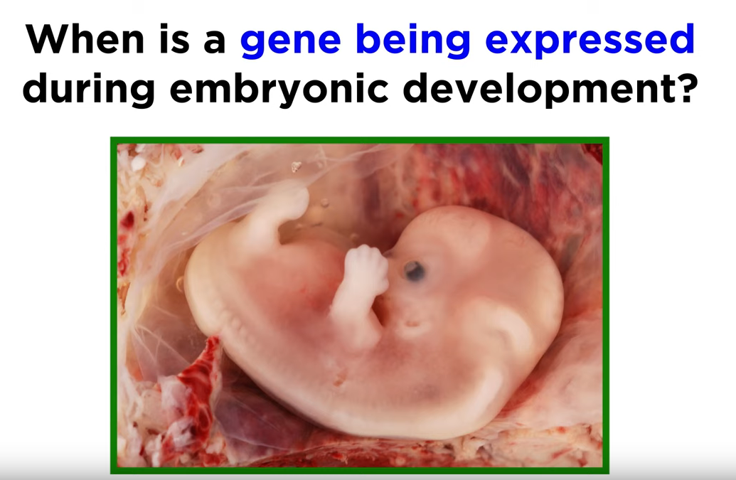

Slide 15
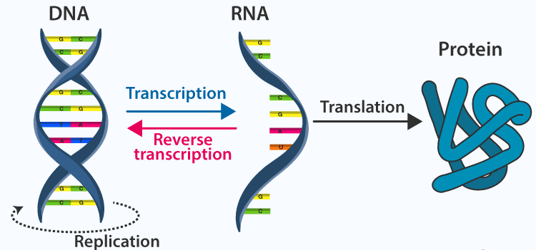
Reverse Transcription

Slide 16
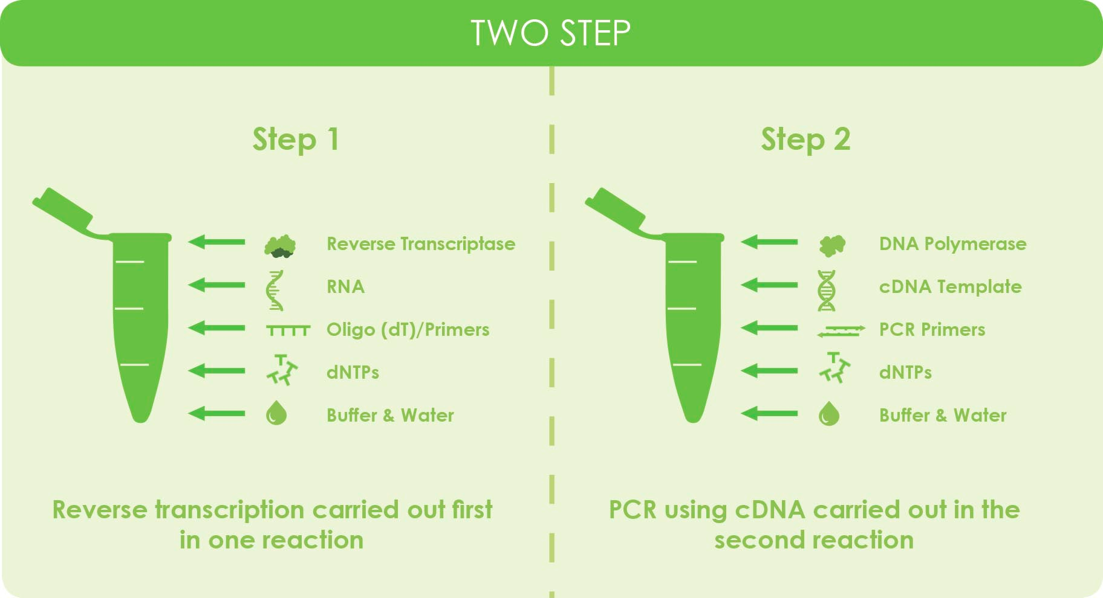
Reverse Transcriptase

Slide 17
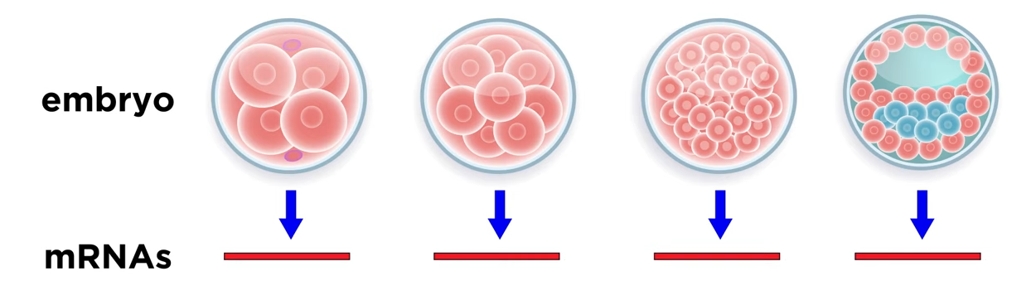
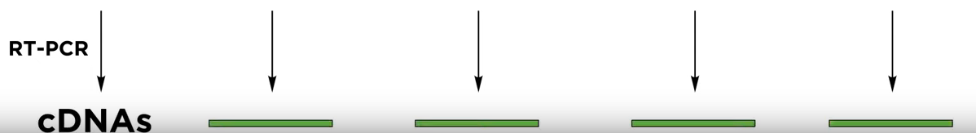
mRNA Isolation and cDNA Preparation

Slide 18
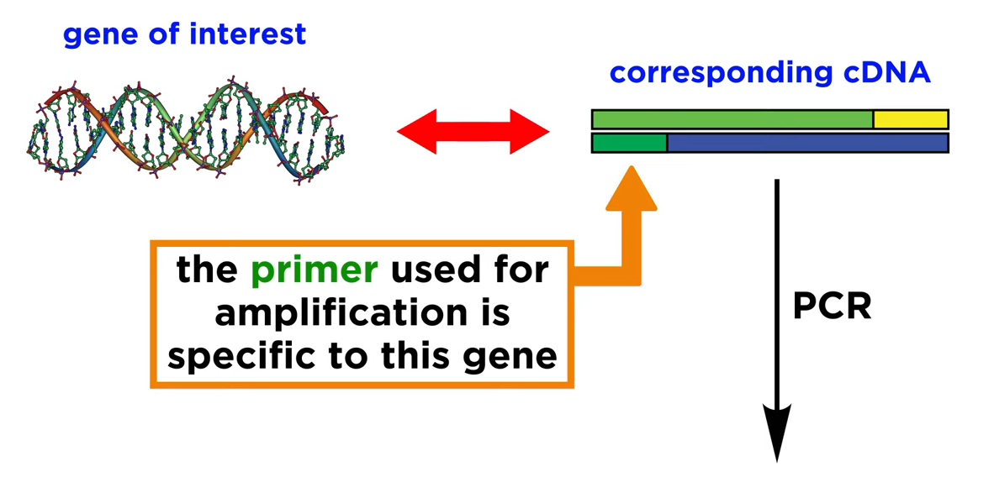
PCR for Target Gene
Multiple copies of the cDNA

Slide 19
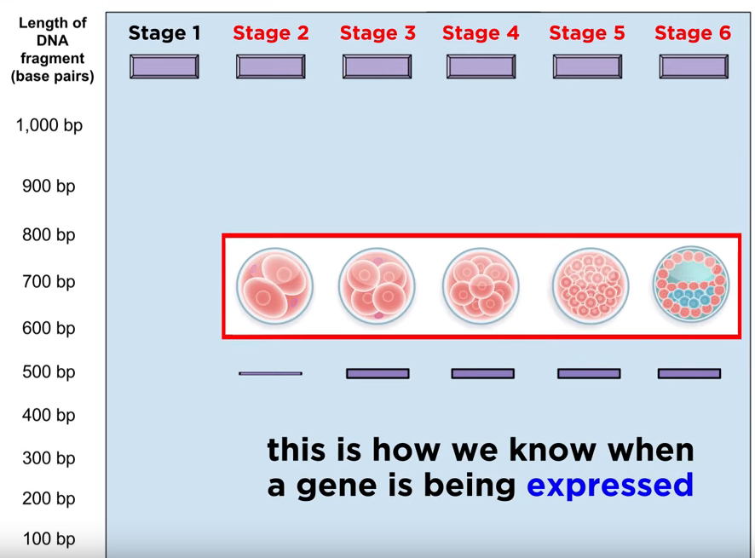
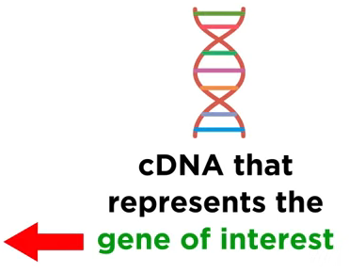
Gel Electrophoresis

Slide 20
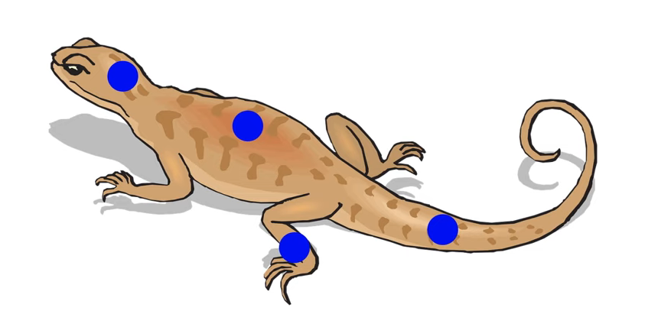
Identification of Tissue Specificity of a particular Gene
mRNA
cDNA
Gene of interest

Slide 21

Genome Wide Expression: Microarray
A laboratory tool used to detect the expression of thousands of genes at the same time.
DNA microarrays are microscope slides that are printed with thousands of tiny spots in defined positions
Each spot containing a known DNA sequence or gene.

Slide 22
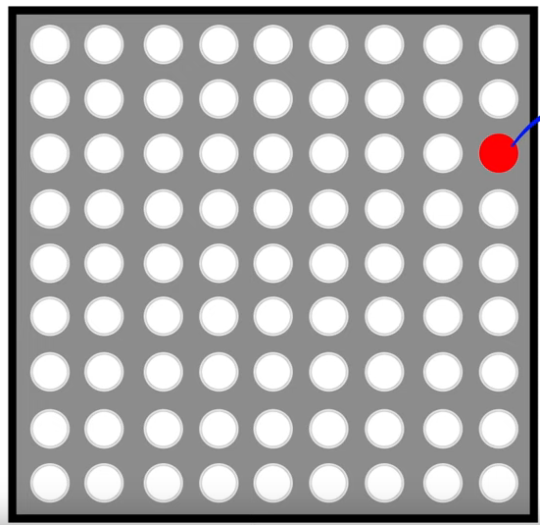
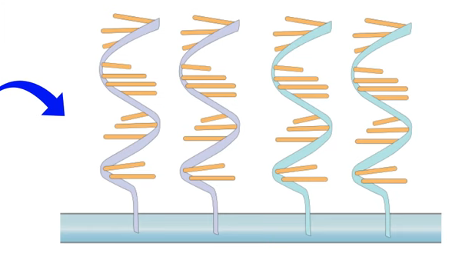
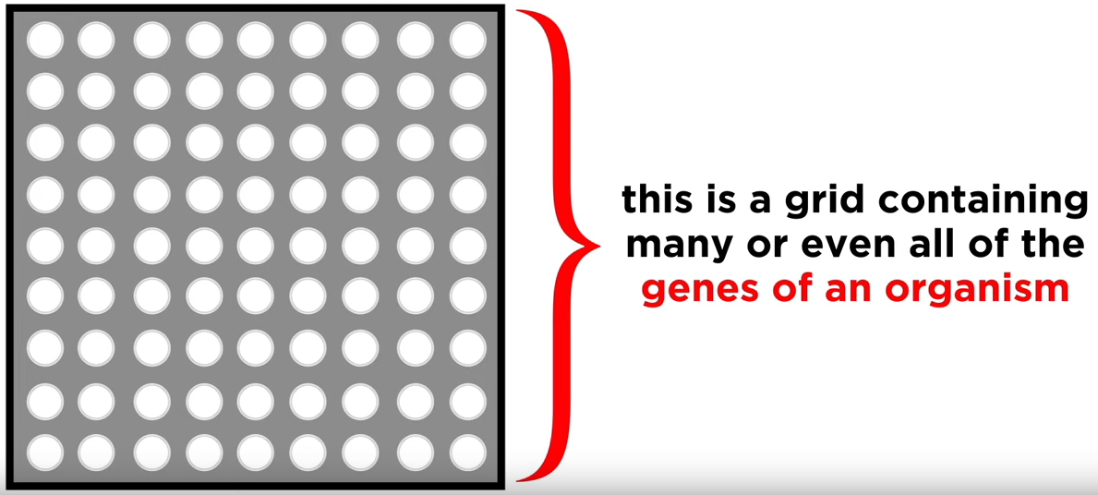
Microarray
Single-stranded DNA probes tethered to a solid support.
These represent a particular known gene

Slide 23
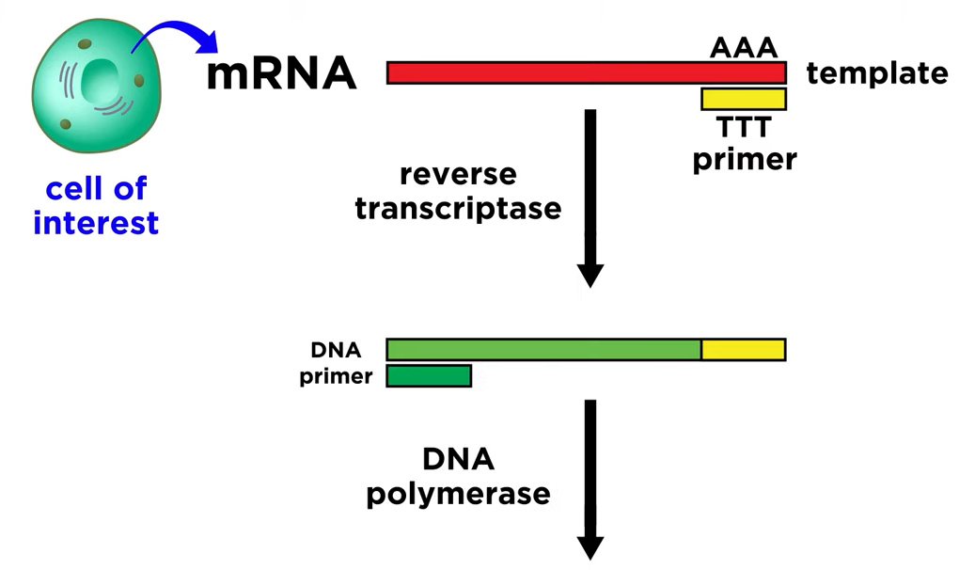

mRNA to cDNA
Complementary DNA (cDNA)

Slide 24

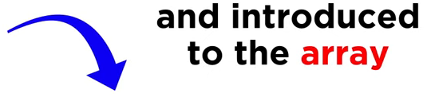
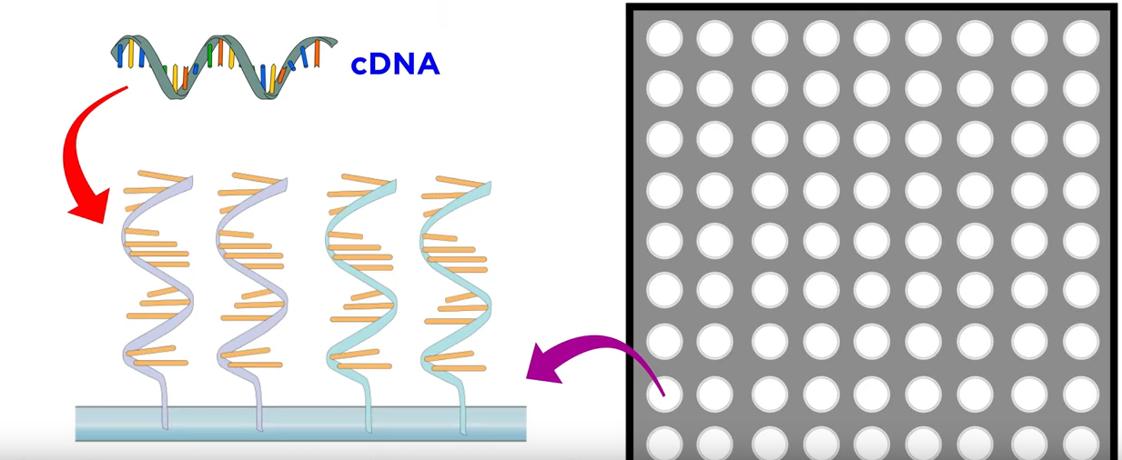
Labeled cDNA

Slide 25
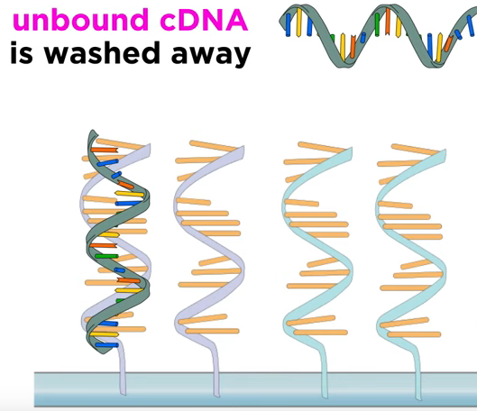
Hybridization

Slide 26
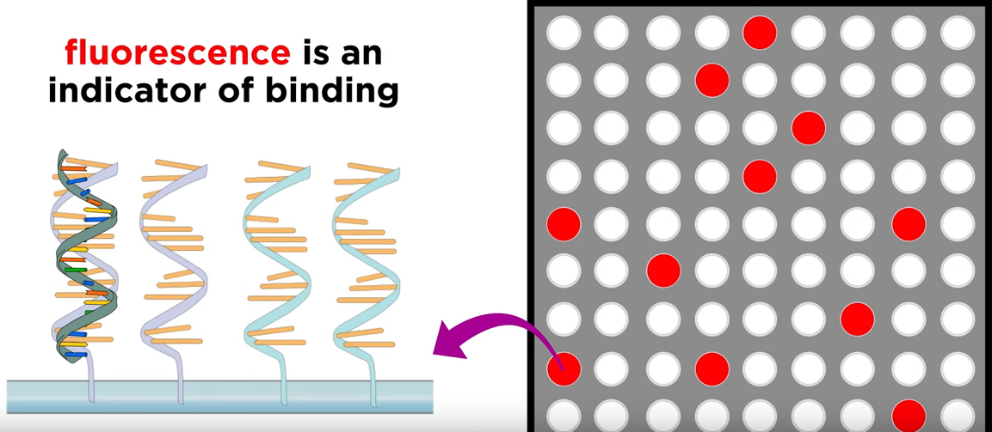
Fluorescence Reading

Slide 27
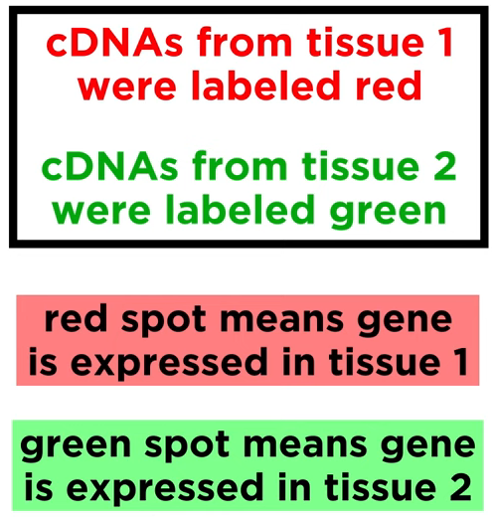
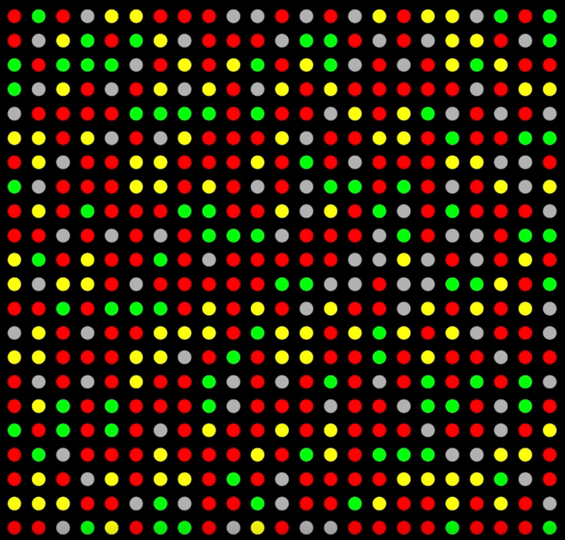
Data Analysis
Yellow spot means both cDNAs bind and gene expressed in both tissues
Grey spots means gene is not expressed in both tissues

Slide 28
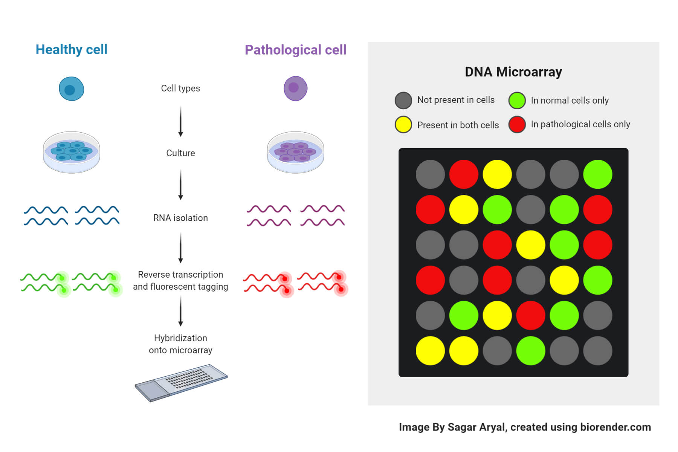
Gene Differentiation of Healthy cells & Diseased Cells

Slide 29
THANK YOU

